Slide 1
QUIZ System.
multiple-choice quiz using the command line.

Slide 2
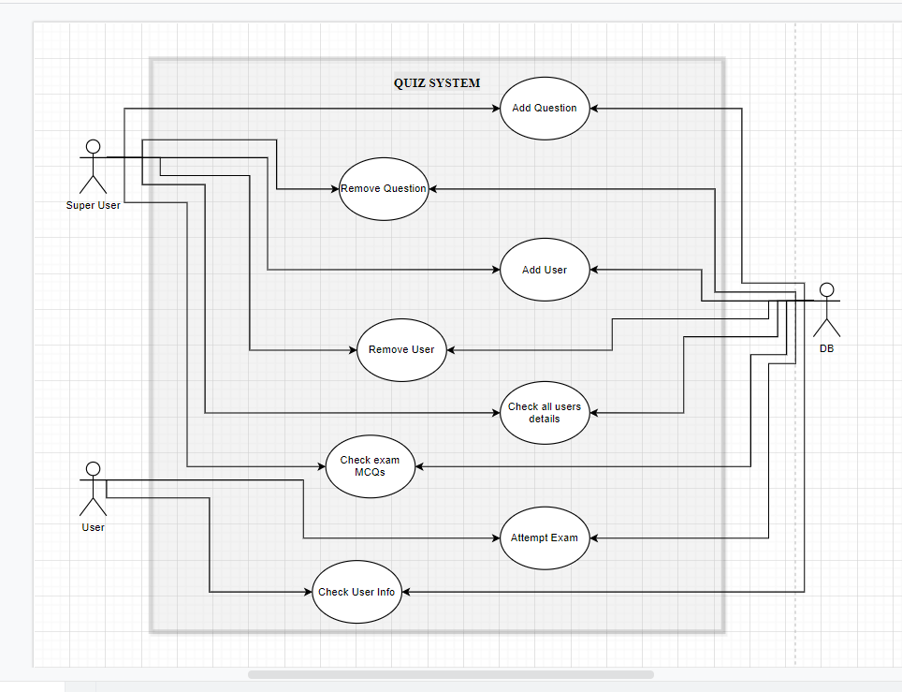
Use-case diagram

Slide 3
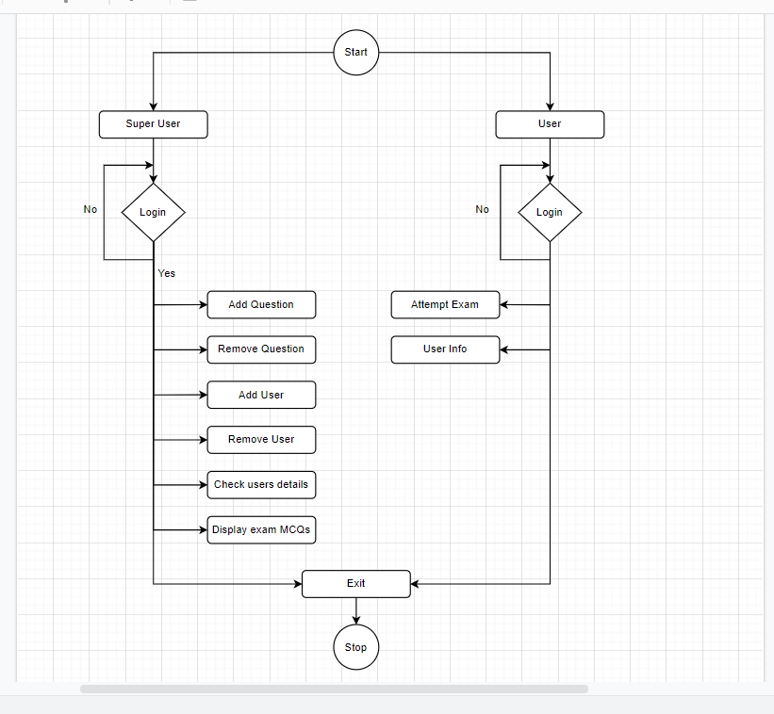
flowchart diagram

Slide 4
Thankyou
Lets move to coding part

